Slide 1

BLOCKCHAIN IMPLEMENTATION FOR AGRICULTURAL FOOD SUPPLY CHAIN USING HYPERLEDGER FABRIC
In the name of Allah, Most Gracious, Most Merciful.
Presented By:
C213062 Miraj Mahmud
C213042 MD Abdullah
C213090 Ashraf Ali Rakib
Dept. of CSE, IIUC
Supervised By:
Abdullahil Kafi Assistant Professor,
Dept. of CSE, IIUC
Department of Computer Science and Engineering
International Islamic University Chittagong

Slide 2

Contents of the presentation
Introduction
Problem Statement
Research Objective
Literature Review
Methodology
Performance Analysis
Result & Comparative Analysis
Conclusion
References

Slide 3
Introduction
In this project, we will build a traceability system to support the agri-food supply chain.
To do that, we will use a Permissioned Blockchain.
One of the most popular permissioned blockchains is Hyperledger Fabric.
We will use Hyperledger Fabric to store product information and transfer details in a secure, transparent ledger.
We will use the Raft consensus algorithm to ensure reliable consensus among stakeholders, fault tolerance, and transparency.

Slide 4
What is Blockchain?
Blockchain is a distributed, decentralized, and typically public digital ledger consisting of records called blocks that are used to record transactions across many computers so that any involved block cannot be
altered retroactively, without the alteration of all subsequent blocks.
Comparison between Public Blockchain and Private Blockchain:
Feature | Hyperledger Fabric(Private Blockchain) | Public Blockchains (e.g., Ethereum)
Network Type | Permissioned (Private, Invite-Only) | Permissionless (Public, Open to All)
Privacy | High (Confidential data on private channels) | Low (All transactions are public)
Performance | High Speed (Optimized for business) | Low Speed (Limited by public consensus)
Identity | Participants are Known and Verified | Participants are Anonymous/Pseudonymous

Slide 5
Problem Statement
Counterfeit and low-quality products infiltrate the agri-food supply chain, posing significant health risks, financial losses, and eroding consumer trust.
Traditional supply chain systems are opaque, centralized, and vulnerable to tampering, allowing for the introduction of fake goods.
Inefficient tracking and fragmented processes make verifying the authenticity of products challenging, delaying the identification and removal of unsafe items.
A secure, transparent, and decentralized system is needed to strengthen traceability and ensure the quality and safety of food, protecting public health and upholding trust in the industry.

Slide 6
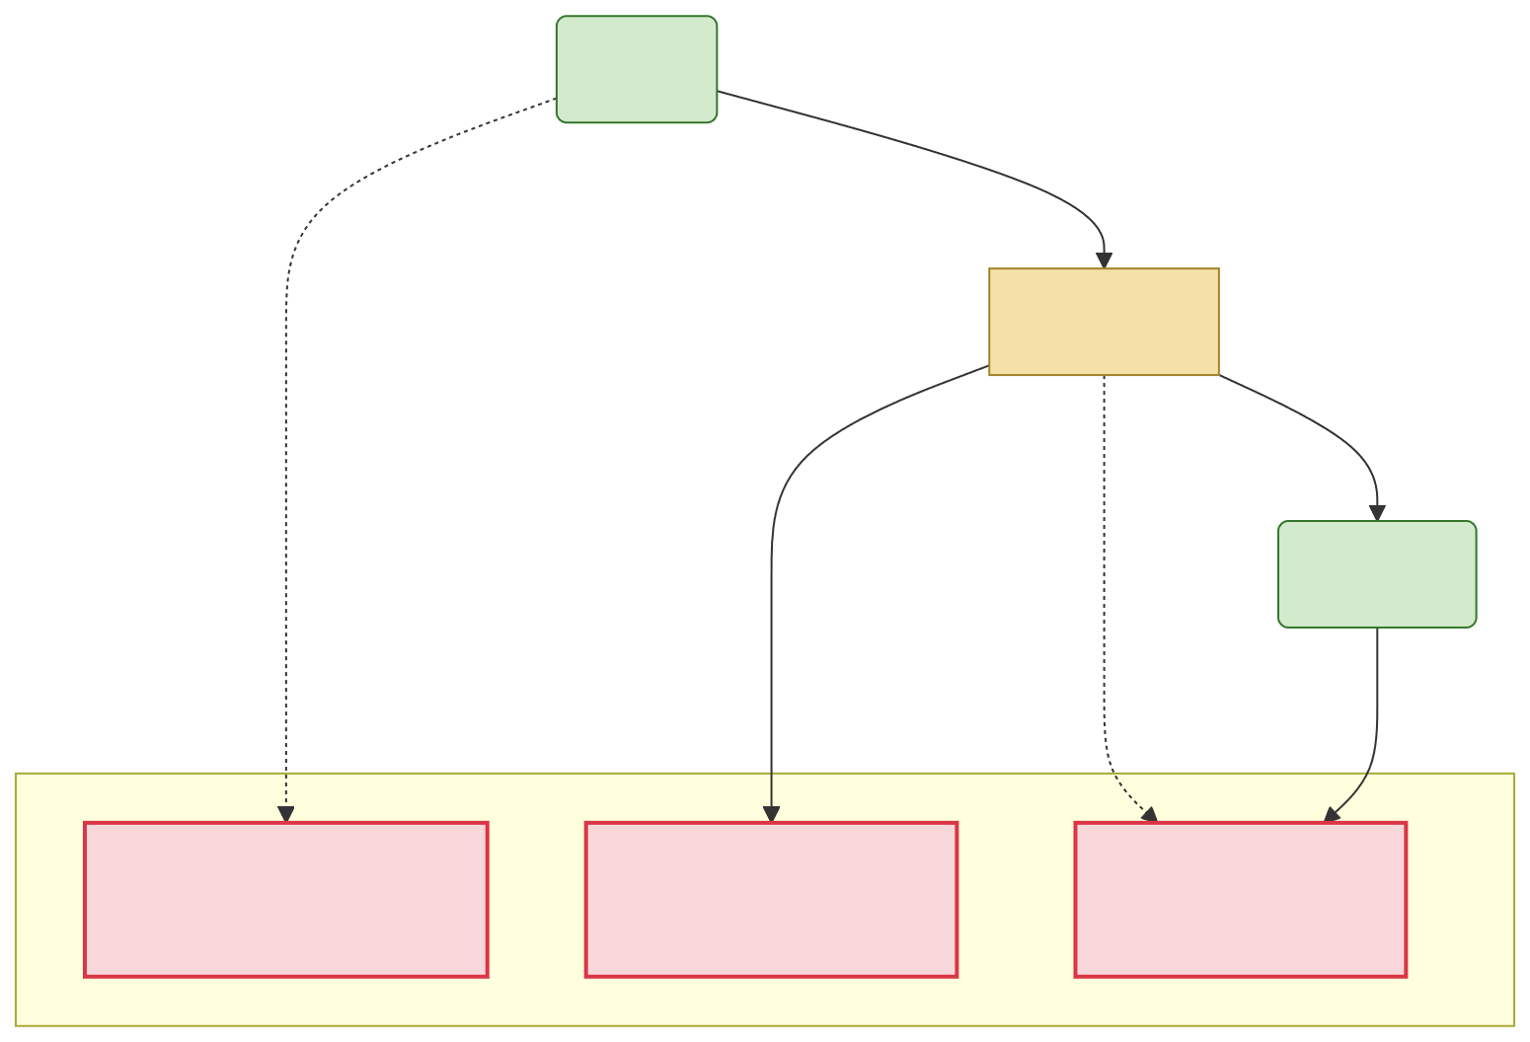
Problem Statement
Farmer
Raw Product
Retailer
No Transparency
Final Product
Weak Link
No Verification
Consumer
Lack of Trust
Exploitation
Unverifiable Quality
Fake/Low-Quality
Goods
Lack of Trust
No Traceability
Problems
Figure : Broken Supply Chain Diagram

Slide 7
Research Objectives
To develop a secure and transparent blockchain-based system using Hyperledger Fabric to ensure the traceability and authenticity of agri-food products.
To enhance supply chain efficiency with real-time tracking capabilities and timely verification of product quality.
To design a scalable and reliable solution that ensures system performance while adapting to the growing needs of the agricultural industry.

Slide 8
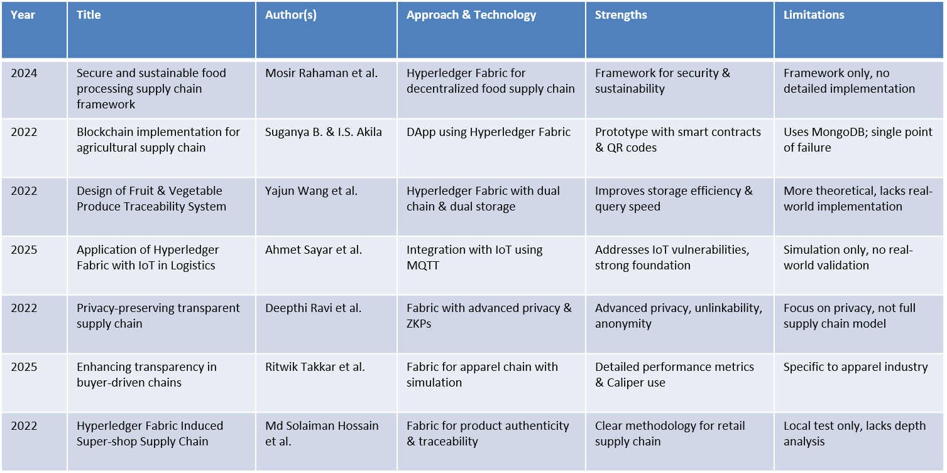
Literature Review

Slide 9
Tools Used
Technology | Tools | Description | Used For
Operating System | Ubuntu | A Linux-based OS is known for its stability, security, and compatibility with open-source tools. | Development and deployment environment
Platform | Hyperledger Fabric | A modular blockchain platform providing enterprise-grade scalability and privacy. | Blockchain network
Container | Docker, Docker Compose | Tools for containerization and orchestration, ensuring a consistent and portable environment. | Managing network components as containers
Language | Go | A statically typed language known for performance and simplicity. | Writing smart contracts (chaincode)
Database | LevelDB | A simple, fast key-value store used as the state database for the Certificate Authority (CA) backend. | CA backend

Slide 10
Methodology
Contents:
Features of Hyperledger Fabric
Consensus Algorithm
Network Architecture
Network Workflow
Sequence Diagram
Step by step process
Hyperledger Explorer

Slide 11
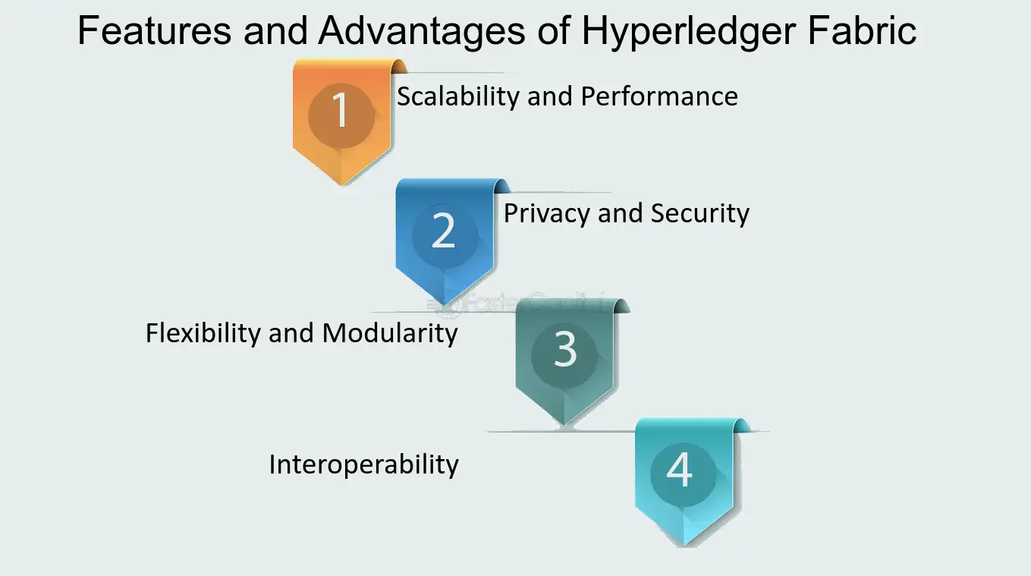
Why Did We Use Hyperledger Fabric?
Scalability and Performance: Hyperledger Fabric’s modular architecture efficiently handles high transaction volumes, ensuring scalability for the growing Agricultural supply chain.
Privacy and Security: Fabric’s permissioned network with robust identity management and encryption ensures data privacy and integrity for authorized participants.
Flexibility and Modularity: The modular structure of Hyperledger Fabric allows easy customization and integration, such as quality checks and traceability.
Interoperability: Fabric enables seamless integration with other blockchain networks and legacy systems, improving collaboration and transparency across platforms.
Fig: Features of Hyperledger Fabric

Slide 12
Raft Consensus Algorithm
Raft is a leader-based consensus algorithm that allows distributed systems to agree on a sequence of values even in the presence of failures.
It is commonly used in resilient, strongly-consistent distributed systems, ensuring that nodes in the network maintain a consistent state despite network partitions or crashes.
Raft is primarily used in distributed SQL databases for leader election and data replication, with each shard of data having its own Raft group for replication.
Why Use Raft?
Correctness: Raft ensures that every operation on the data is consistent and ordered, ensuring correct execution in distributed systems.
Dynamic Membership: Raft allows dynamic changes in the network’s membership, making it easier to add or remove nodes without affecting the system's overall functionality.
Fault Tolerance: Raft ensures that data replication continues even if a majority of the nodes are still operational, allowing the system to function despite failures.

Slide 13
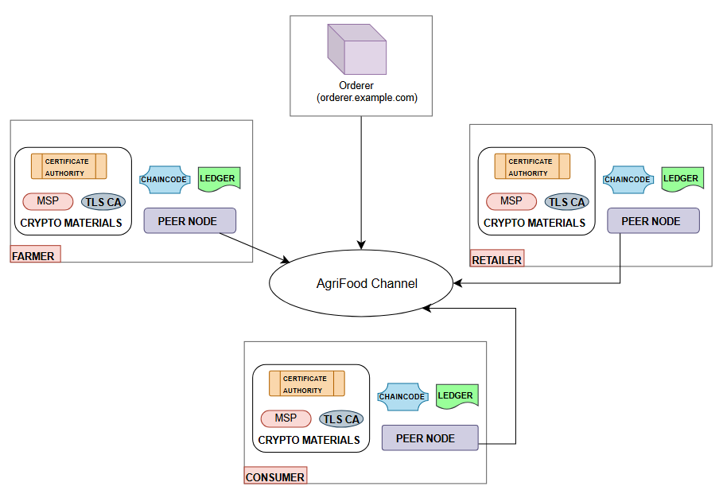
Network Architecture
Steps:
Certificate Authority Setup
Peer Node Configuration
Channel Creation
Chaincode Deployment
Ledger Initialization
Orderer Node Setup
Transaction Processing

Slide 14
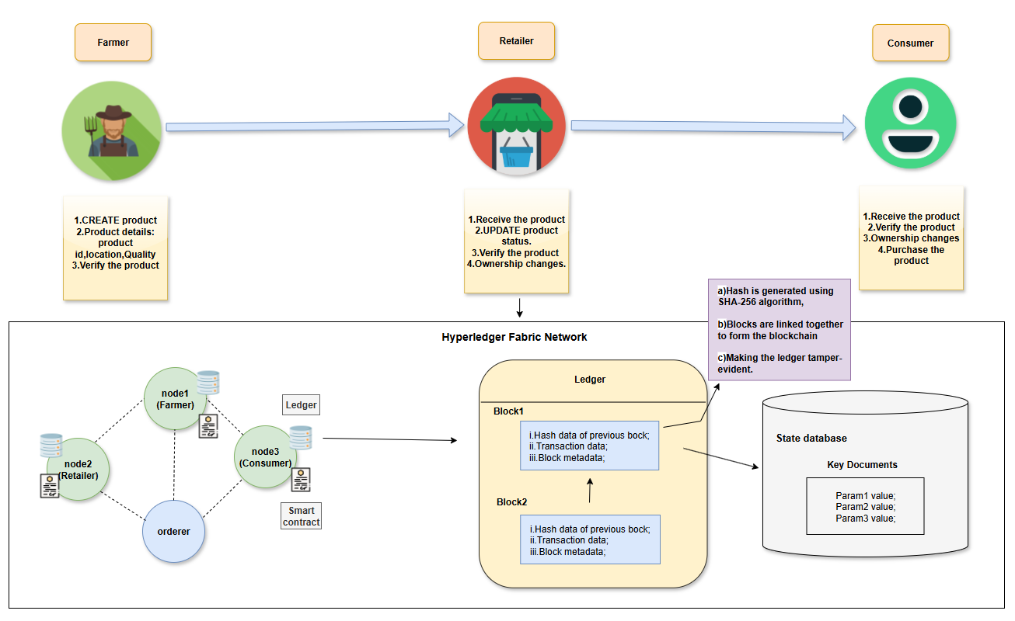
Network Workflow

Slide 15
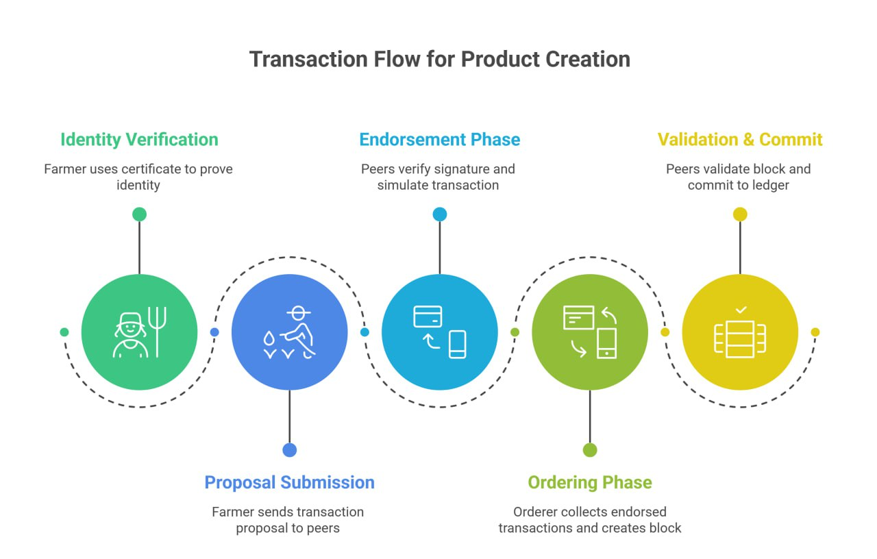

Slide 16
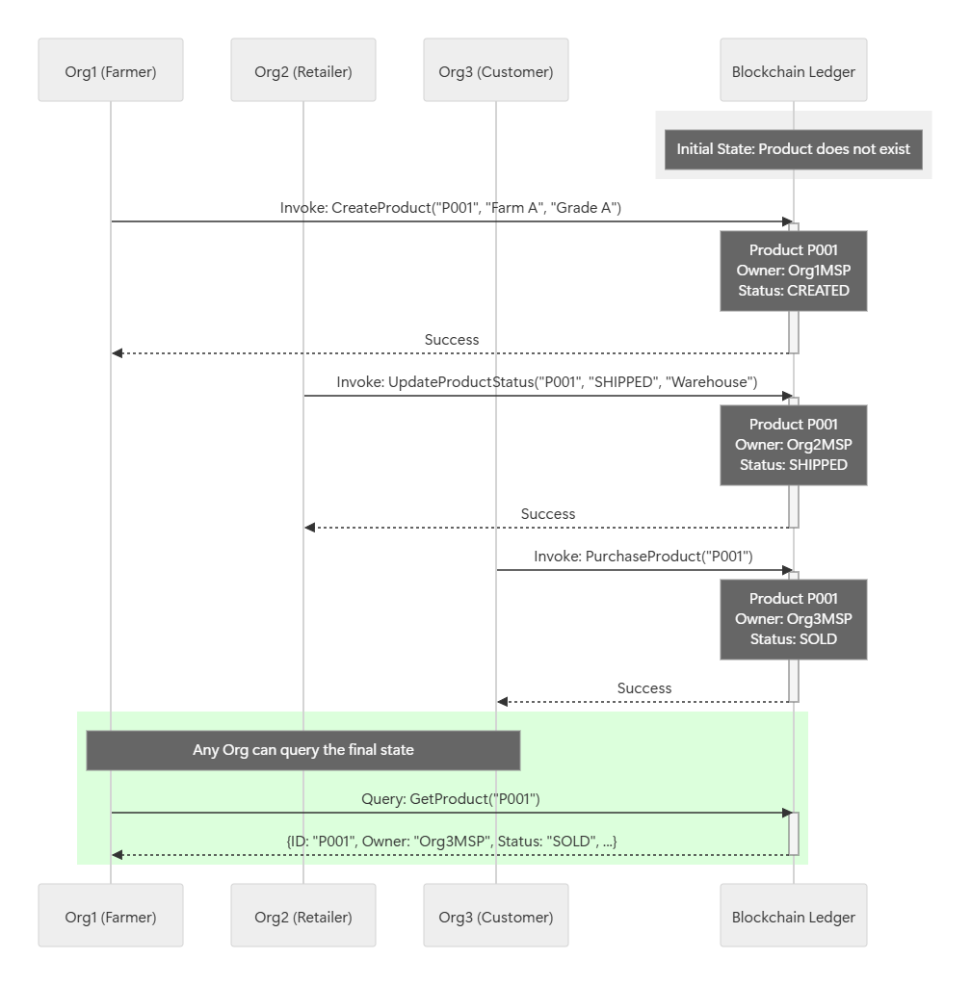
Sequence Diagram

Slide 17
Methodology: Step by step process
This Diagram illustrates the journey of an agricultural product from farm to consumer, with each key step recorded on the blockchain.
Step 1: CreateProduct (Farmer): The farmer creates a new product record on the blockchain with details like ID, location, and quality.
Step 2: UpdateProductStatus (Retailer): The retailer updates the product's status and acquires ownership. The chaincode enforces that only a retailer can perform this action.
Step 3: PurchaseProduct (Customer): The customer purchases the product from the retailer. The chaincode enforces that only the customer can perform this final transaction.
Verification: At any point, any participant can query the ledger to view the product’s current status, ensuring traceability.

Slide 18
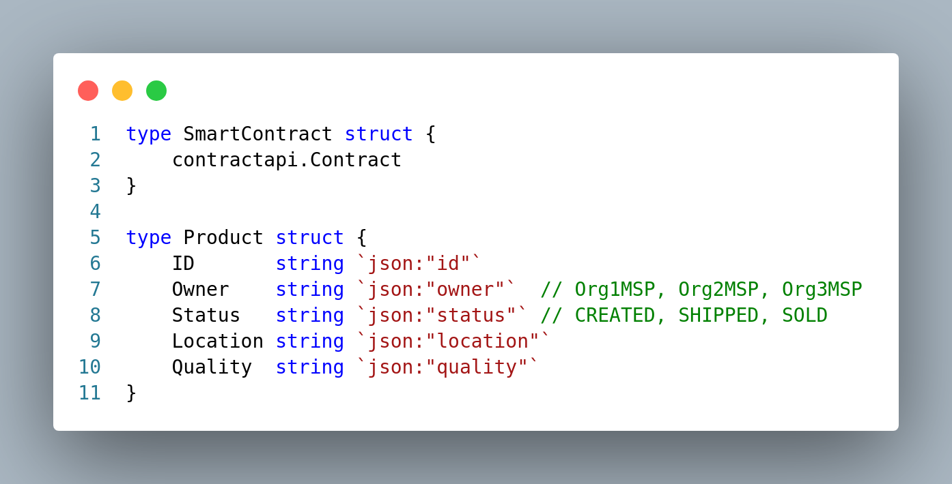
Necessary Chaincode
Product Structure

Slide 19
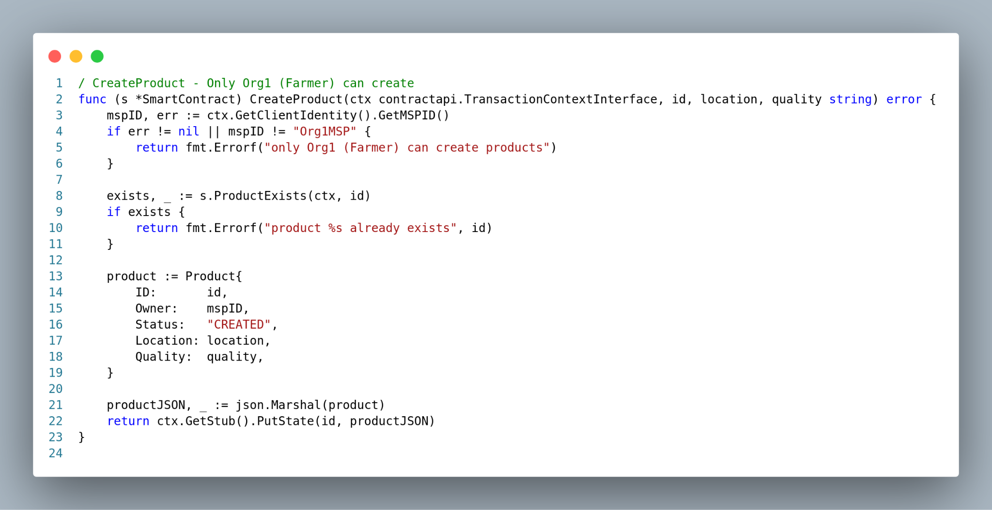
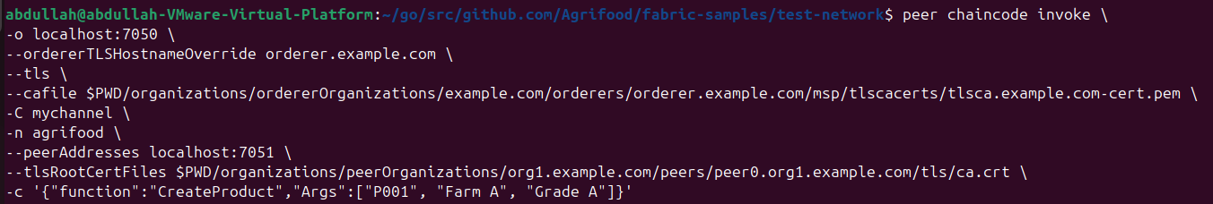
Necessary Chaincode & CLI Command
Step 1: CreateProduct (Farmer):
Fig: Chaincode invoke result of Adding a New Product

Slide 20
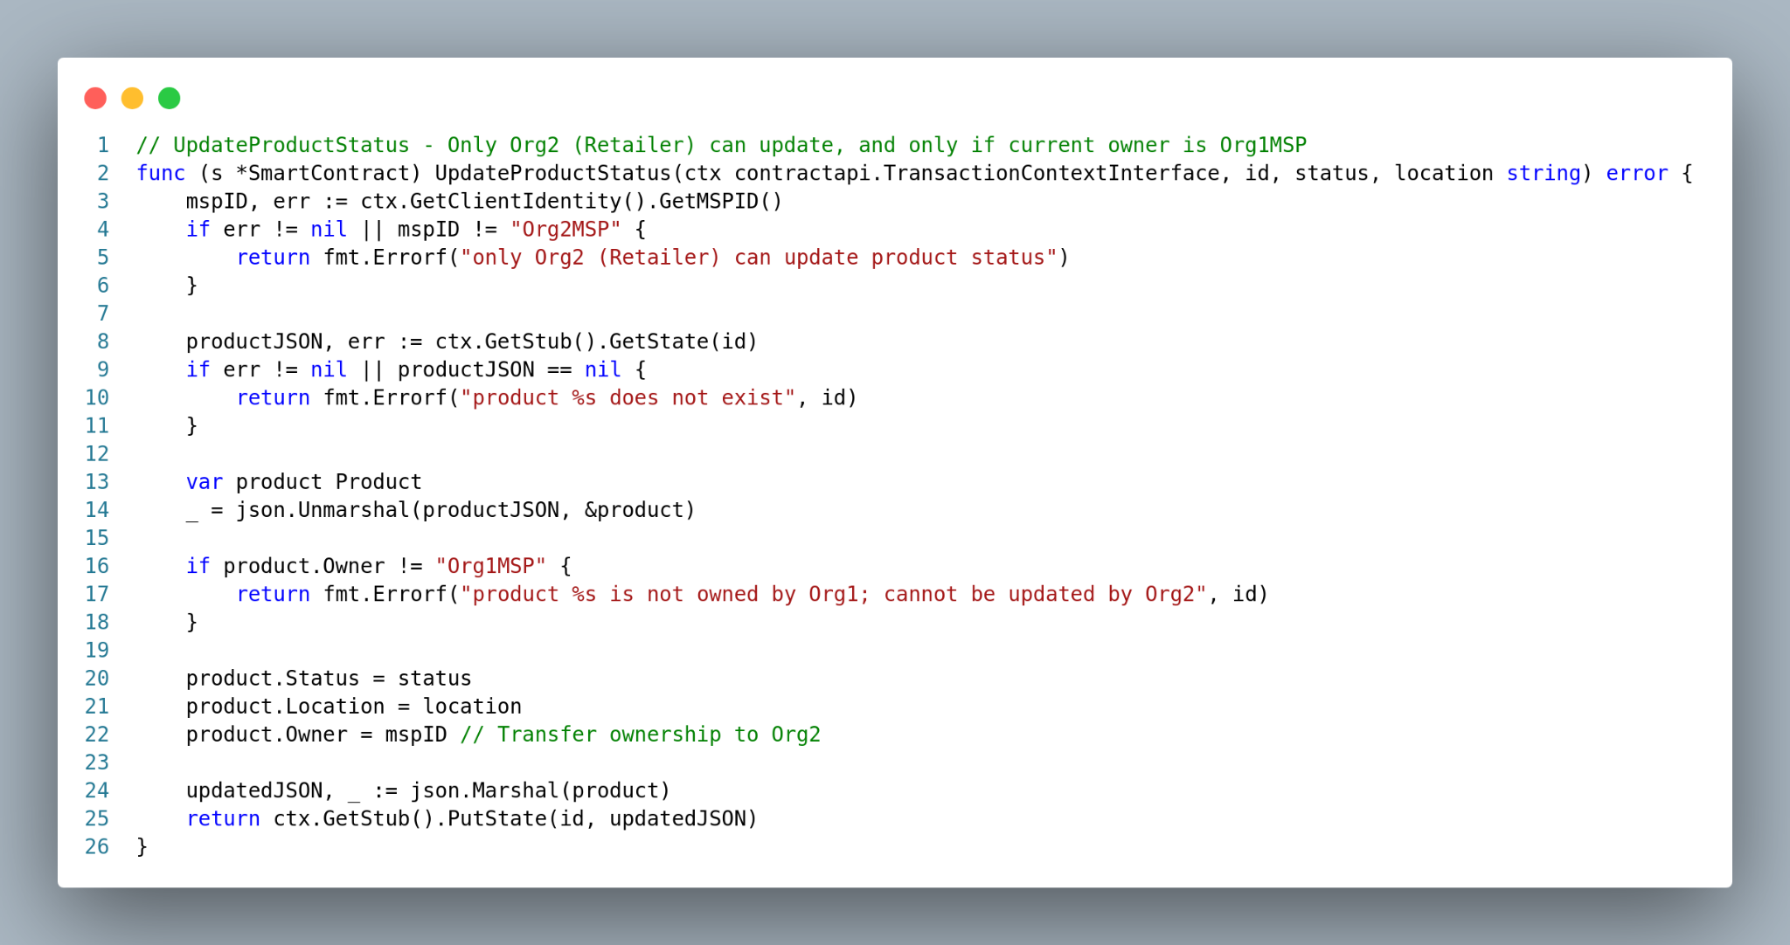
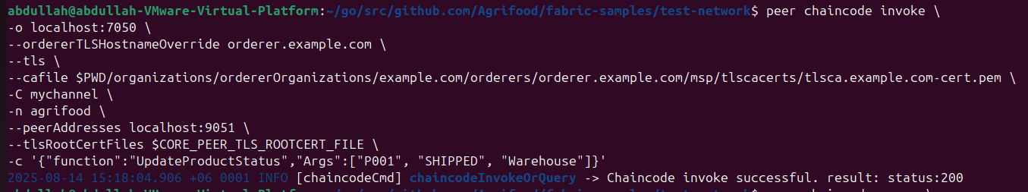
Necessary Chaincode & CLI Command
Step 2: UpdateProductStatus (Retailer):
Figure : Update Product Status (Farmer->Retailer)

Slide 21
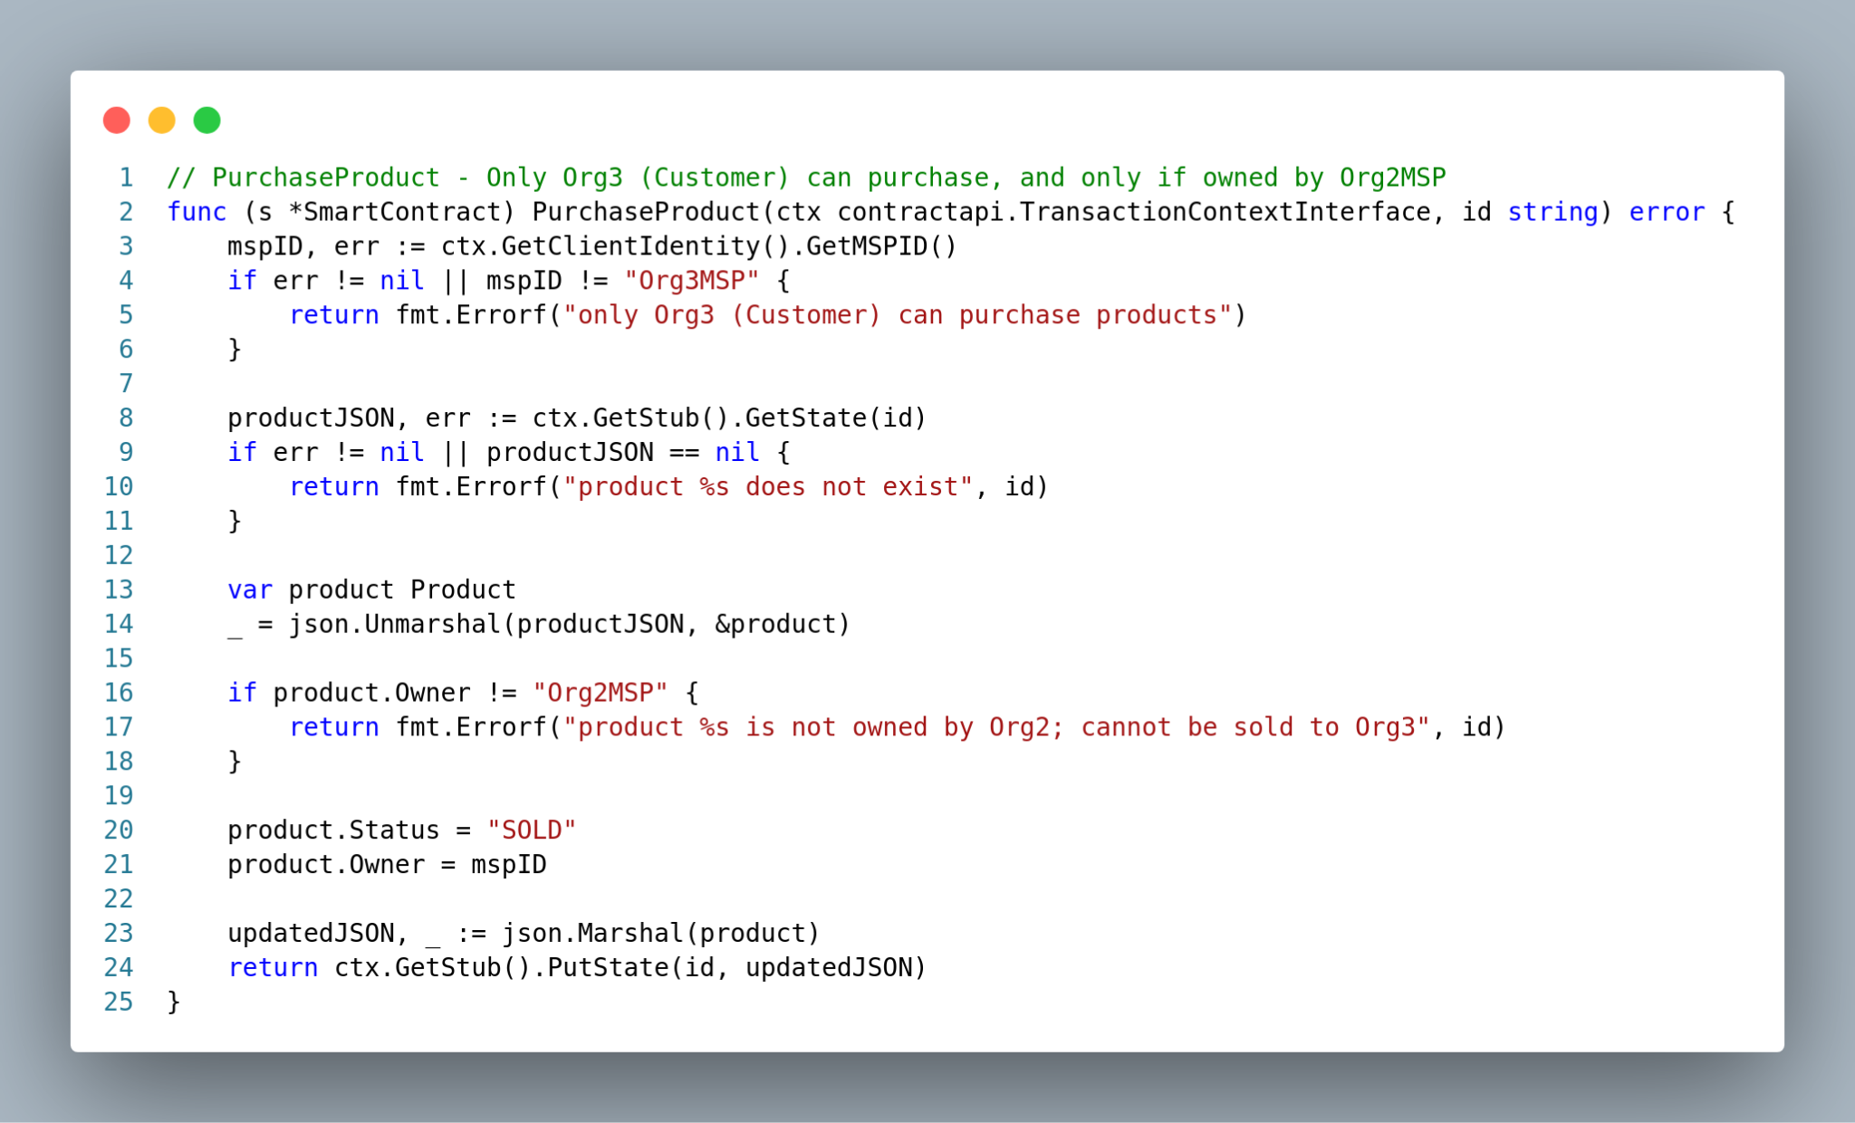
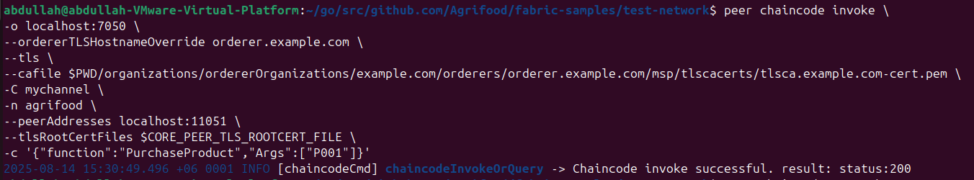
Necessary Chaincode & CLI Command
Step 3: PurchaseProduct (Customer):
Figure : Purchase Product (Retailer->Customer) )

Slide 22
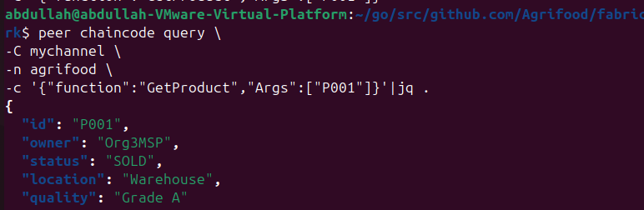
Necessary CLI Command
Verification: Any participant can check product current status
Figure : Verification

Slide 23
Necessary CLI Command
Retailer attempts to create a product
peer chaincode invoke \ -o localhost:7050 \ --ordererTLSHostnameOverride orderer.example.com \ --tls\ --cafile $PWD/organizations/ordererOrganizations/example.com/orderers/orderer.example.com/msp/tlscacerts/tlsca.example.com-cert.pem \-C mychannel \ -n agrifood\--peerAddresses localhost:9051 \ --tlsRootCertFiles $CORE_PEER_TLS_ROOTCERT_FILE \ -c '{"function":"CreateProduct","Args":["P888", "CityMarket", "Grade B"]}'
Expected Result: The command will return an error, as the smart contract logic detects that the caller's MSP ID (Org2MSP) is not Org1MSP. The transaction will be rejected, and no new product will be created on the ledger.

Slide 24
Integrating Hyperledger Explorer
Hyperledger Explorer is a powerful dashboard for visualizing our blockchain network in real-time.
It allows us to view all network transactions, blocks, and the state of the ledger, which is invaluable for validating our system.
Verification of Immutability: We can inspect each block's hash and see how it links to the previous block, proving that the ledger is tamper-proof.
Proof of Traceability: The dashboard provides a clear transaction history for each product, allowing us to trace its journey from the farmer to the consumer.

Slide 25
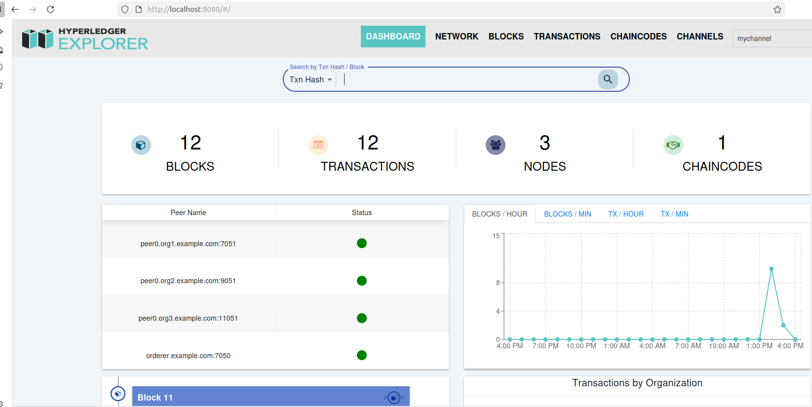
Integrating Hyperledger Explorer
Monitoring the Live Network:
.
Figure : Explorer Dashboard

Slide 26
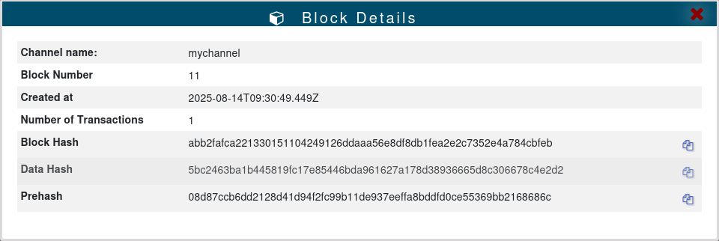
Integrating Hyperledger Explorer
.
Figure : A Block Details

Slide 27
Monitoring the Live Network:
.
A Transaction Created
Explorer Dashboard
Figurer : Explorer Dashboard
Transaction Block Details

Slide 28
Results: Validation of Business Rules
Proof of a Secure System
Test Case | Action | Performed By | Result | Business Rule Verified
1 | CreateProduct | Org1 (Farmer) | ✅ Success | Only the Farmer can create new products.
2 | CreateProduct | Org2 (Retailer) | ❌ Failure (Error) | A Retailer cannot create products.
3 | UpdateProduct Status | Org2 (Retailer) | ✅ Success | The Retailer can update products from the Farmer.
4 | PurchaseProduct | Org3 (Customer) | ✅ Success | The Customer can purchase from the Retailer.
.
These results prove that the system is not just a theoretical model but a functional application that enforces its rules with precision.

Slide 29
Performance Analysis
Parameters | Proposed System (Fabric + Raft)
CPU Usage (%) | 64
Latency (ms) | 186
Memory Usage (GB) | 7
Throughput (TPS) | 89
TPS at 20 Nodes | 95
Uptime (%) at 50% Node Failure | 93

Slide 30
Comparative Analysis

Slide 31
Comparative Analysis

Slide 32
Comparative Analysis
Feature | Our Project | Hossain et al. (2022) | Sayar et al. (2025) | Wang et al. (2022) | Ravi et al. (2022) | Takkar et al. (2025) | Rahaman et al. (2024)
Core Application | Agri-Food | Supermarket | Logistics & IoT | Fruit & Vegetable | Coffee | Apparel | Food Processing
Supply Chain Model | Simple Linear (3-Stage) | Complex Multi-Product | IoT-Driven | Complex Multi-Stage | Complex Multi-Stage | Complex Assembly | Complex Multi-Stage
Key Innovation | Practical Implementation | Multi-Channel Privacy | IoT & MQTT Integration | Dual-Chain Architecture | Advanced Privacy | Multi-Channel Privacy | Sustainability Framework
Smart Contract Lang. | Go (Golang) | Node.js | Not Specified | Not Specified | Go | Go (Golang) | Solidity
Performance Analysis | Yes | No | No | Yes (Query Time) | Yes (Caliper) | Yes (Simulation) | No
Reproducibility | High (Full Scripts) | Medium (Architecture) | Low (Conceptual) | Medium (Architecture) | Medium (Architecture) | Medium (Sim. Code) | Low (Conceptual)
Explorer | Yes | No | No | No | No | No | No
Canal Lock | Yes | No | No | No | No | No | No

Slide 33
Comparative Analysis
Feature | Our Project | Other Frameworks
Core Idea | A practical, reproducible, end-to-end prototype. | Mostly theoretical frameworks or partial implementations.
Logic | Simple, linear Farmer -> Retailer -> Customer flow. | Often complex, multi-stage, or industry-specific.
Reproducibility | High (with full scripts provided in appendix). | Low to Medium (lacks full deployment protocols).
Validation | Includes both successful and failed test cases to prove access control. | Often focuses only on successful transactions.
Visualization | Integrates Hyperledger Explorer to visually demonstrate results. | Typically does not include real-time visualization tools.

Slide 34
Contribution & Future Work
Our Contributions:
A Practical End-to-End Implementation: A working proof-of-concept, not just a theoretical model.
A Verifiable Blueprint: A detailed, replicable methodology from code to deployment.
Validation of Business Logic: Proof that the smart contract correctly enforces supply chain rules.
Future Work:
Develop a User Interface (UI): Create a web or mobile app for easier interaction.
Use QR Codes: Enable customers and stakeholders to scan a QR code to quickly verify and check the complete history of a product.
Integrate IoT Sensors: Automate data entry for location, temperature, etc.
Implement Private Data Collections (PDCs): For confidential data like pricing.

Slide 35
Conclusion
This thesis successfully implemented and validated a blockchain-based traceability system for the agricultural food supply chain using Hyperledger Fabric.
The system creates a secure, transparent, and immutable record of a product's journey from the Farmer to the Customer.
The smart contract's role-based access control was proven to be effective, ensuring that participants can only perform their designated functions.
The project serves as a complete and viable blueprint for creating similar permissioned blockchain networks in the agrifood industry.

Slide 36
References
[1]D. C. K. Lin, S. H. Liu, C. M. Chen, and Y. C. Wang, “Blockchain in agriculture traceability systems: A review,” Applied Sciences, vol. 10, no. 12, p. 4113, Jun. 2020, doi: 10.3390/app10124113.
[2]S. Balasubramanian and I. S. Akila, “Blockchain implementation for agricultural food supply chain using hyperledger fabric,” Journal of Intelligent & Fuzzy Systems, vol. 43, no. 5, pp. 5387–5398, Sep. 2022.
[3]R. S. et al., “A review on blockchain based traceability in organic food supply chain,” International Research Journal of Modernization in Engineering Technology and Science, vol. 6, no. 2, pp. 58-63, Feb. 2024.
[4]A. Shahbandeh, “Supply chain management system using hyperledger fabric,” International Journal of Innovative Science and Research Technology, vol. 10, no. 5, pp. 1352-1358, May 2025.
[5]D. Kumar, A. K. Singh, and R. Kumar, “Blockchain based logistics protocol using hyperledger fabric,” International Journal of Innovative Research in Electrical, Electronics, Instrumentation and Control Engineering, vol. 13, no. 4, pp. 1-6, Apr. 2025.
[6]Y. Liu, Z. Wang, and Z. Zhang, “Hyperledger fabric-based tea supply chain production data traceable scheme,” Sustainability, vol. 15, no. 18, p. 13738, Sep. 2023, doi: 10.3390/su151813738.
[7]E. Androulaki et al., “Hyperledger fabric: A distributed operating system for permissioned blockchains,” in Proc. Thirteenth EuroSys Conf., Porto, Portugal, Apr. 2018, pp. 1–15, doi: 10.1145/3190508.3190538.
[8]S. Saberi, M. Kouhizadeh, J. Sarkis, and L. Shen, “Blockchain technology and its relationships to sustainable supply chain management,” International Journal of Production Research, vol. 57, no. 7, pp. 2117–2135, 2019, doi: 10.1080/00207543.2018.1533261.
[9]N. Kshetri, “Blockchain’s roles in meeting key supply chain management objectives,” International Journal of Information Management, vol. 39, pp. 80–89, Apr. 2018, doi: 10.1016/j.ijinfomgt.2017.12.005.

Slide 37
References
[10]Hyperledger Fabric, “Channels.” Channels — Hyperledger Fabric Docs main documentation. Accessed: 10/02/2025.
[11]L. Wang, G. Ding, Y. Zhao, D. Wu, and C. He, “Optimization of LevelDB by separating key and value,” Parallel and Distributed Computing, Applications and Technologies, PDCAT Proceedings, vol. 2017 December, pp. 421–428, Jul. 2017, doi: 10.1109/PDCAT.2017.00074.
[12]The Linux Foundation, “Deploying a smart contract to a channel,” Hyperledger Fabric documentation, 2024. Available: https://hyperledger-fabric.readthedocs.io/en/latest/deploy_chaincode.html. Accessed: 25/03/2025.
[13]Docker,Inc, “Docker overview.” https://docs.docker.com/get-started/overview/. Accessed: 10/05/2025.
[14]Docker,Inc, “Use containers to Build, Share and Run your applications.” https://www. docker.com/resources/what-container/. Accessed: 22/05/2025.
[15]D. Huang, X. Ma, and S. Zhang, “Performance Analysis of the Raft Consensus Algorithm for Private Blockchains,” IEEE Trans Syst Man Cybern Syst, vol. 50, no. 1, pp. 172–181, Jan. 2020, doi: 10.1109/TSMC.2019.2895471.
[16]Hyperledger Fabric, “The Ordering Service.” The Ordering Service — Hyperledger Fabric Docs main documentation . Accessed: 15/02/2025.
[17]The Linux Foundation, “Using the test network,” Hyperledger Fabric documentation, 2024. Available: https://hyperledger-abric.readthedocs.io/en/latest/test_network.html. Accessed: 16/03/2025.
[18]A. Sayar, M. C. Kurtbaş, Ç. Sancaktar, R. D. Kabak, and Ş. Çakmak, “Application of Hyperledger Blockchain Technology to Logistics Supply Chain with IoT,” Procedia Computer Science, vol. 252, pp. 814–823, 2025.
[19]A. Kamilaris, A. Fonts, and F. X. Prenafeta-Boldú, “The rise of blockchain technology in agriculture and food supply chains,” Trends in Food Science & Technology, vol. 91, pp. 640–652, Sep. 2019, doi: 10.1016/j.tifs.2019.07.034

Slide 38
THANK YOU

